Slide 1
Sri Adi Shankaracharya (CE 788-820)
-By
TANUSHREE SANWAL
ASSISTANT PROFESSOR
KIET

Slide 2
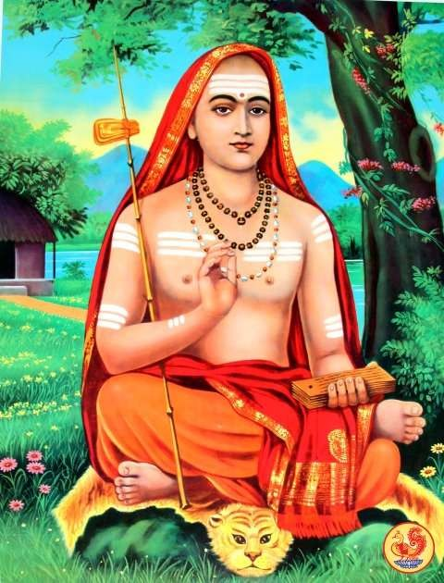

Slide 3
INTRODUCTION
Adi Shankaracharya was the first philosopher who consolidated doctrine of Advaita Vedanta (अद्वैत वेदान्त), one of the sub- schools of Vedanta. He is credited with unifying and establishing the main currents of thought in Hinduism.

Slide 4
Advaita Vedanta
Advaita Vedānta ( Sanskrit: अद्वैत वेदान्त, literally, "non-duality") is a school of Hindu philosophy, and is a classic system of spiritual realization in Indian tradition. The term Advaita refers to the idea that Brahman alone is ultimately real, the phenomenal transient world is an illusory appearance (maya) of Brahman, and the true self, atman, is not different from Brahman.

Slide 5
Advaita philosophy was originally known as the “Forest Philosophy”. It got this name because it was so sanctified that it was not allowed to be preached to the people and was only practiced in the forests. Advaita Vedānta is the oldest extant sub-school of Vedānta, which is one of the six orthodox (āstika) Hindu philosophies (darśana). Although its roots trace back to the 1st millennium BCE, the most prominent exponent of the Advaita Vedānta is considered by tradition to be the 8th century scholar Adi Shankara.

Slide 6
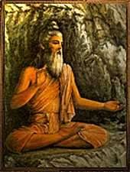
LIFE OF THE SHANKARACHARYA
Birth- 788 CE
birth place -at Kalady (Kerala) Childhood name- Shankara Parents -Sri Sivaguru and Aryamba. Brahmin

Slide 7
Childhood
It was after his parents, who had been childless for many years, prayed at the Vadakkunnathan temple, Thrissur that Sankara was born under the star Thiruvathira.
His father died while Shankara was very young. By the time, Shankara didn't complete three years. Shankara's upanayanaṃ, the initiation into student-life, was performed at the age of five. As a child, Shankara showed remarkable scholarship, mastering the four Vedas by the age of eight.

Slide 8
HIS TEACHER
Under the guidance of Govindapada, Shankara mastered everything in Hatha, Raja and Jnana Yoga in only three years, after which he received initiation in the knowledge of Brahma.
Shankaracharya was also blessd by the Ageless Yogi, Maha Muni Babaji, who taught him perfection of the Raja yoga disciplines. He practiced in the Himalayas at Kedarnath how to attain the spontaneous state of consciousness

Slide 9
SANYASA DEEKSHA
Sankara took Sanyasa deeksha (oath of ascetic life) during his 9th year. So he never married and never had family and family- life.

Slide 10
SADHANA
Shankaracharya practiced his Sadhana in the Himalayas at Kedarnath

Slide 11
HIS CONTRIBUTION
His works in Sanskrit discuss the unity of the Ātman and Nirguna Brahman "brahman without attributes". He wrote copious commentaries on the Vedic canon(BrahmaSutras, Principal Upanishads and Bhagavad Gita) in support of his thesis. His works elaborate on ideas found in the Upanishads. Shankara's publications criticised the ritually-oriented Mīmāṃsā school of Hinduism. He also explained the key difference between Hinduism and Buddhism, stating that Hinduism asserts "Ātman (Soul, Self) exists", while Buddhism asserts that there is "no Soul, no Self" At Badari he wrote his famous Bhashyas ("commentaries") and Prakarana grant has ("philosophical treatises").

Slide 12
Creation
Shankara is most known for his systematic reviews and commentaries (Bhasyas) on ancient Indian texts. Shankara's masterpiece of commentary is the Brahmasutrabhasya (literally, commentary on Brahma Sutra), a fundamental text of the Vedanta school of Hinduism.
His commentaries on ten Mukhya (principal) Upanishads are also considered authentic by scholars, and these are: Bhasya on the Brihadaranyaka Upanishad, the Chandogya Upanishad, the Aitareya Upanishad, the Taittiriya Upanishad, the Kena Upanishad, the Isha Upanishad, the Katha Upanishad, the Mundaka Upanishad, the Prashna Upanishad, and the Mandukya Upanishad. Of these, the commentary on Mandukya, is actually a commentary on Madukya-Karikas by Gaudapada

Slide 13
BHAJA GOVINDA
For children, Shankara wrote the Bhaja Govindam, a musical rhythmic verse, which was so lyrical that children would sing it to themselves over and over again unaware of the profound effect it was having on their spiritual evolution.

Slide 14
MOHA MUDGARA
He also wrote of attachment in the Moha Mudgara, which removed the delusions of the youth and reaffirmed the faith of those who were already following his beliefs.

Slide 15
IMPORTANT MATHAS
Sringeri Sharada Peetham, Sringeri
.Sringeri in Karnataka in the south.
Dwaraka in Gujarat in the west 3- Puri in Orissa in the east,
4- Jyotirmath (Joshimath) in Uttarakhand in the north.

Slide 16
CONTRUBUTION FOR THE YOGA
Adi Sankaracharya believed in the philosophy of "non-dualism"
His teachings are based on the unity of the soul and Brahman -
which can be identified with the Supreme God.

Slide 17
KARMAYOGA
. He Uses the word
- in this Geeta Bhashya i.e. mental clinging to the fruits of actions distracts. Therefore any doer of actions who has given up mental clinging to the fruits is a yogin, his mind concentrated, not being distracted. Hence Karma Must not be neglected.

Slide 18
Shankaracharya gained expertise in different forms of Yoga that included Hatha, Raja and Jnana yoga. He then received the knowledge of Brahma.

Slide 19
FINAL DAY(718AD)
He was just thirty-two years of age and his work (Mission) was completed.
Adi Shankara travelled to the Himalayan area of Kedarnath- Badrinath and attained videha mukti ("freedom from embodiment"). There is a
samadhi mandir dedicated to Adi Shankara behind the Kedarnath temple.

Slide 20
CONCLUSION
Shankaracharya has been paralleled with the great spiritual teachers, such as Buddha and Christ in that they were Avataras each said to be highly evolved spiritually at birth.
“The thoughts of Shankara sums up the goal of mankind, every living creature aspires to realize, where there is no fear, jealousy nor passions, only love and the desire of perfect beatitude “.

Slide 21
REFERENCES
Madhava-Vidyarana, ‘Sankara Digvijaya, The Traditional Life of Sri Sankaracharya’, (1986),
Sri Ramakrishna Math, Madras, India
Paramahamsa Niranjanananda Saraswati, ‘Sannyasa Darshan’, (1993),
Sri Panchdashnam Paramahamsa Alakh Bara, Rikhiadham ~ Deoghar, Jharkhand, India Swami Mumukshananda (1991), ‘Vedanta - Voice of Freedom’,
Advaita Ashram, India
Swami Satyeswarananda Giri, (1992) ‘Babaji, Vol 1, The Divine Himalayan Yogi,
The Sanskrit Classics, San Diego, USA
Paramahamsa Satyananda - video, (1987) ‘Darshan with Paramahamsaji,
Selected Satsangs at Bihar School of Yoga Ganga Darshan, Bihar, India
‘The Quintessence of Vedanta’, (1960), Sri Ramakrishna Advaita Ashram, Kalady

Slide 22
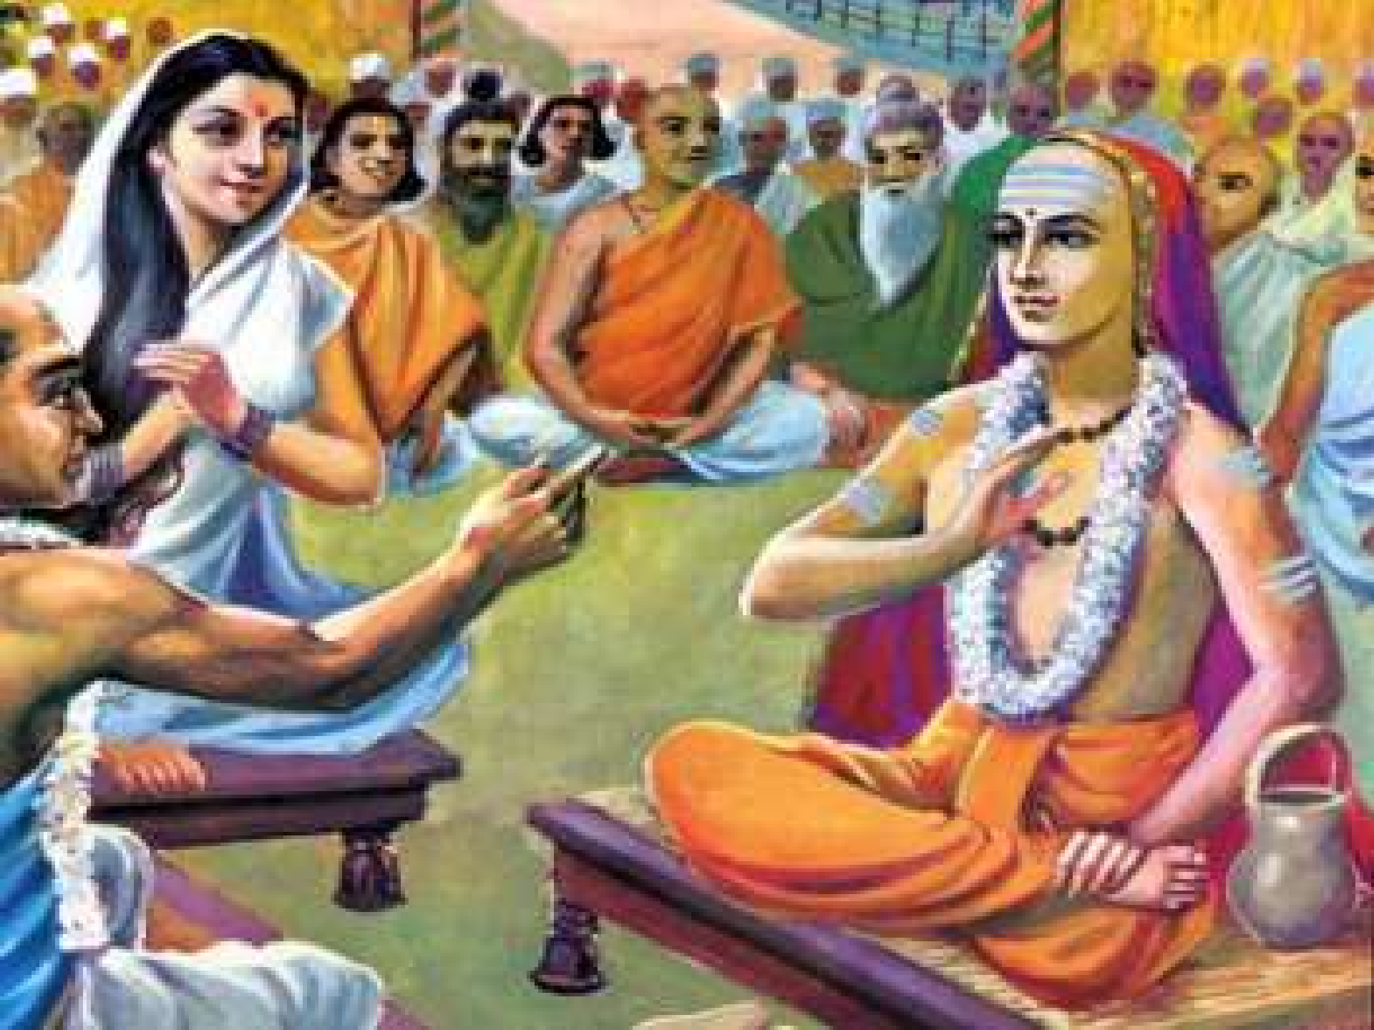

Slide 23
THANK YOU

